Slide 1


OUTPATIENT
DEPARTMENT
Performed Under :
AKHILESH KUMAR MISHRA (053)
ASHISH (029)
ANGSHUMAN PAL (105)
SAURAV KUMAR (109)
RISHAV KUMAR SINGH (052)
Dr. VINAY KUMAR
NATIONAL INSTITUTE OF
TECHNOLOGY, JAMSHEDPUR

Slide 2
CURRENT SCENARIO
NIT Jamshedpur Dispensary is operating in offline mode which includes managing all the facilities manually.
Unavailability of proper system for scheduling of appointment with the doctors leading to waiting in queues for long time or doctors being idle at other times.
Patients are unaware of the visiting hours of the doctors.
Inefficient management of the details of the patients visiting the OPD. Also, no proper system for keeping a track of medical records of each individual patient.

Slide 3
Inappropriate inventory management
Presently there is no efficient management of records of stocks of medicines bought by the dispensary
Also no real time estimation of the count of stocks that are about to finish.
No information of the medicines which have expired or about to expire soon.
Involvement of papers in maintaining various records such as patients visited details, stocks management, prescriptions is very high which makes it way difficult to check, analyse and use for future reference or could be damaged by various factors.
No facility for visit of specialist doctors who would visit certain days of a week.

Slide 4
OUR MOTIVE
To design a system that automates the manual procedure of managing various facilities and activities taking place within the dispensary
Upload of prescription of every patient by the doctor in order to keep track of the disease and medication provided so that the prescription could be easily accessed by the patient from anywhere
Individual patient record could be maintained for various purposes in the future such as viewing, searching, retrieval and manipulation of data.
Details of proper schedule of the visiting hours of the doctor to be present in the web app which could easily accessed.

Slide 5
Keeping details of the daily count of the patients visiting the dispensary reducing the use of papers.
Special column for notifying about the specialist doctor who would be visiting the dispensary
Proper scheduling of appointment for special doctors to avoid queuing at the dispensary and also to limit or fix the number of patients to be checked by the specialist.
Adding a feature of NEWS API for searching and retrieving articles and reports about the recent diseases that are spreading across India in order to keep ourselves updated about the various seasonal viruses and flu.

Slide 6
Efficient inventory management system which includes online adding of medicines and its respective stocks to the system, managing these stocks for easy analysis and manipulation of data, and effortless checking of the expiry date of the stocks.
Shifting of the inventory stock management system online completely reduces the use of huge amount of paper cutting down the paper cost as all the data are computerised.
Improves data accuracy as less human errors and alerts when there’s a shortage of stock.
Increases data security greatly by keeping patients’ records privately and restricts access through role – based access control.

Slide 7
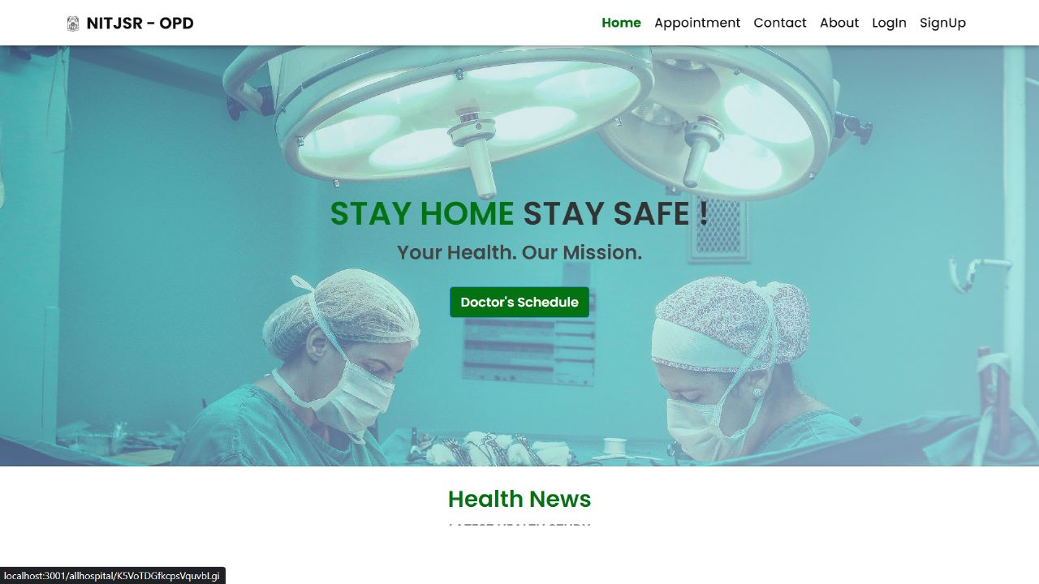
PROJECT OVERVIEW
HOME PAGE
This section contain a navbar which has links for Appointment, Contact, About, Login and Signup section.

Slide 8
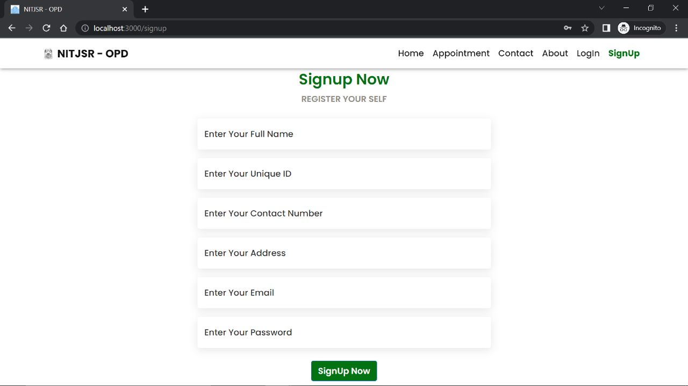
PROJECT OVERVIEW
Signup Module
Users can quickly and easily register to dispensary website by providing required information.

Slide 9
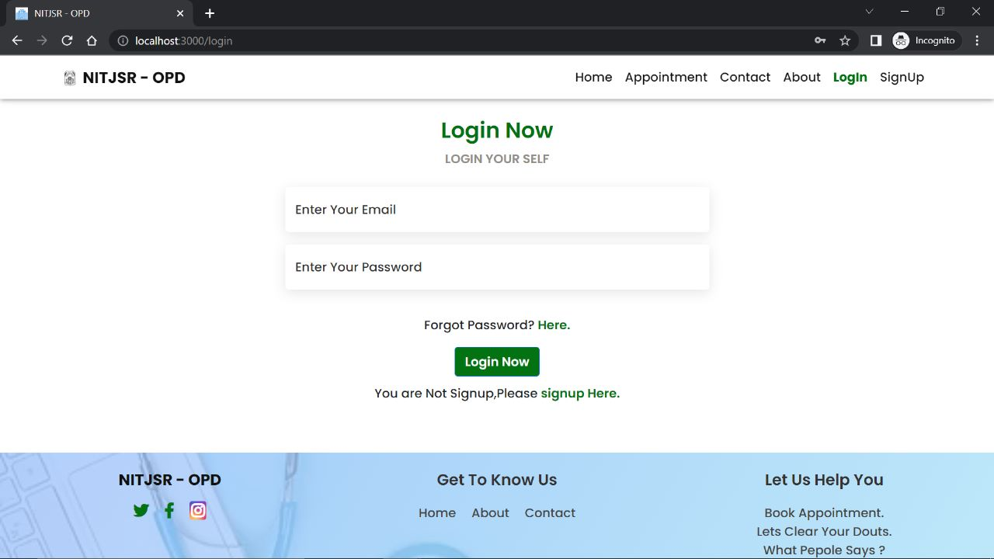
PROJECT OVERVIEW
Login Module
It allows users to type username and password to login.
It allows only users with correct credentials.

Slide 10
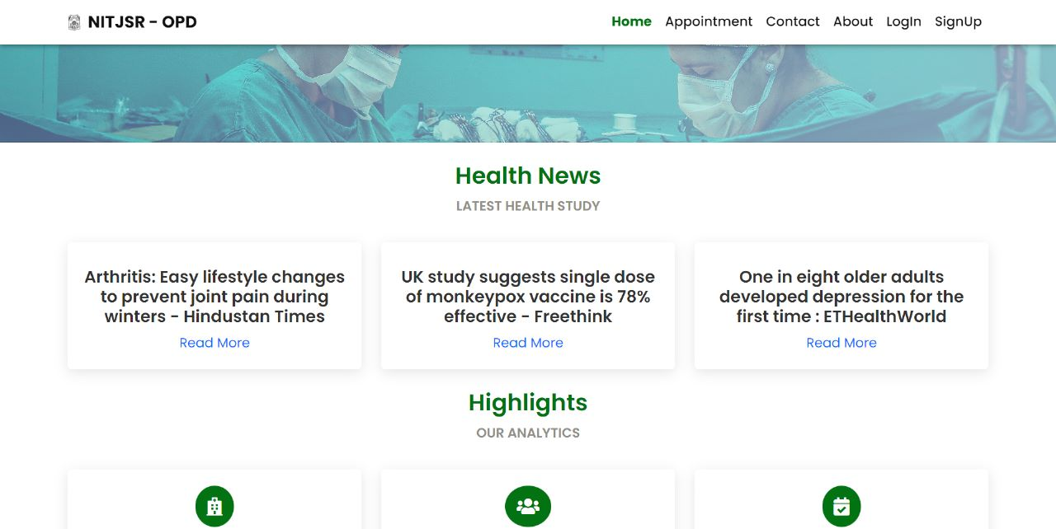
PROJECT OVERVIEW
News Section
This section display the latest news about different diseases spread across India in order to keep ourselves updated about the various seasonal viruses and flues by accessing the reports provided on the website.

Slide 11
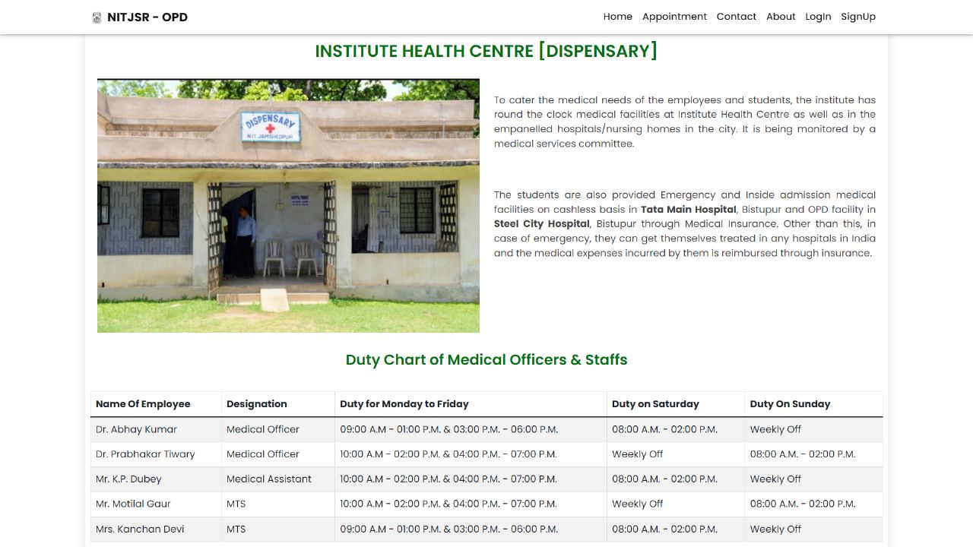
PROJECT OVERVIEW
Dispensary Time Table Section
It shows all the details about the dispensary.
It also shows the duty chart of medical officers and staffs with their visiting day and hour.

Slide 12
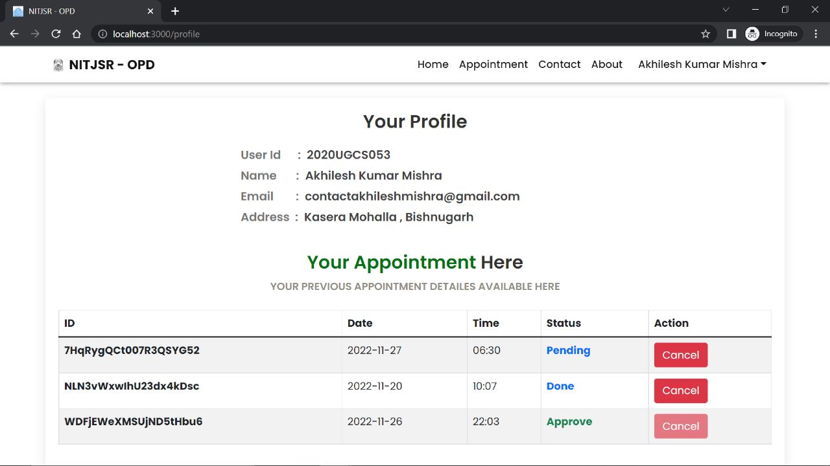
PROJECT OVERVIEW
Users Profile Section
It shows the user’s credentials.
It shows all appointment details with their current status.

Slide 13
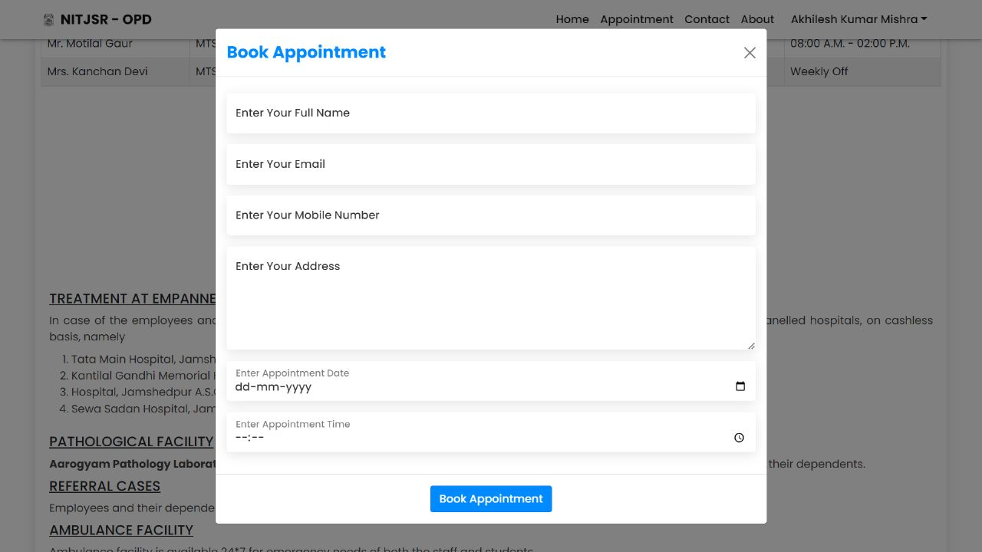
PROJECT OVERVIEW
Appointment Section
Booking online is easiest and best option for making an appointment and receiving immediate confirmation.
In order to book an appointment with doctors, a institute id will be required. If you miss or fail to cancel your appointment within 48 hours, it will be cancelled automatically.

Slide 14
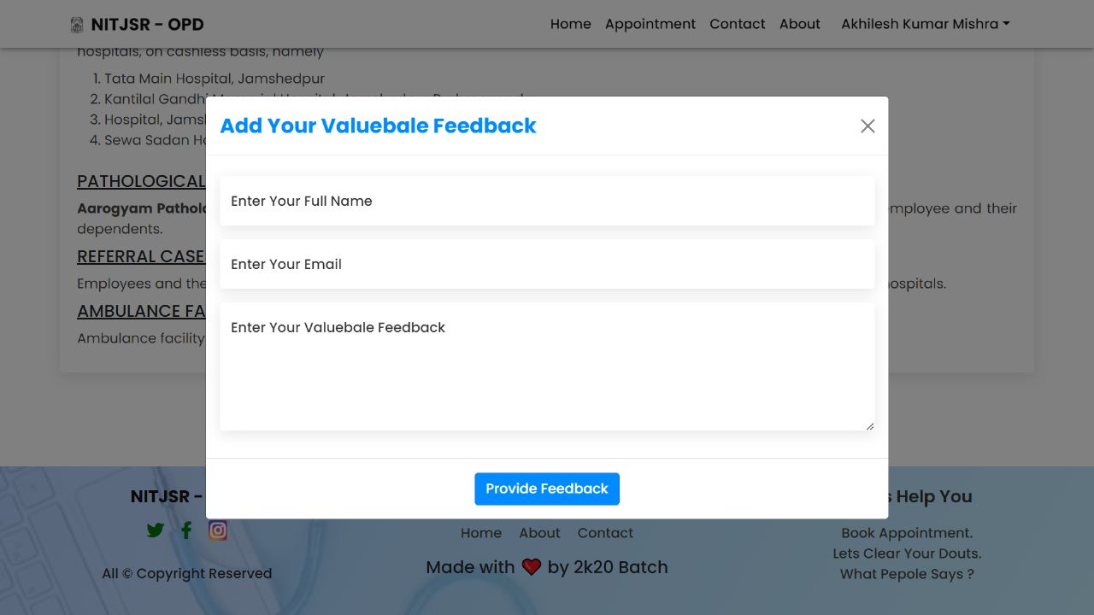
PROJECT OVERVIEW
Feedback Section
Users can give their valuable feedback to the website.

Slide 15
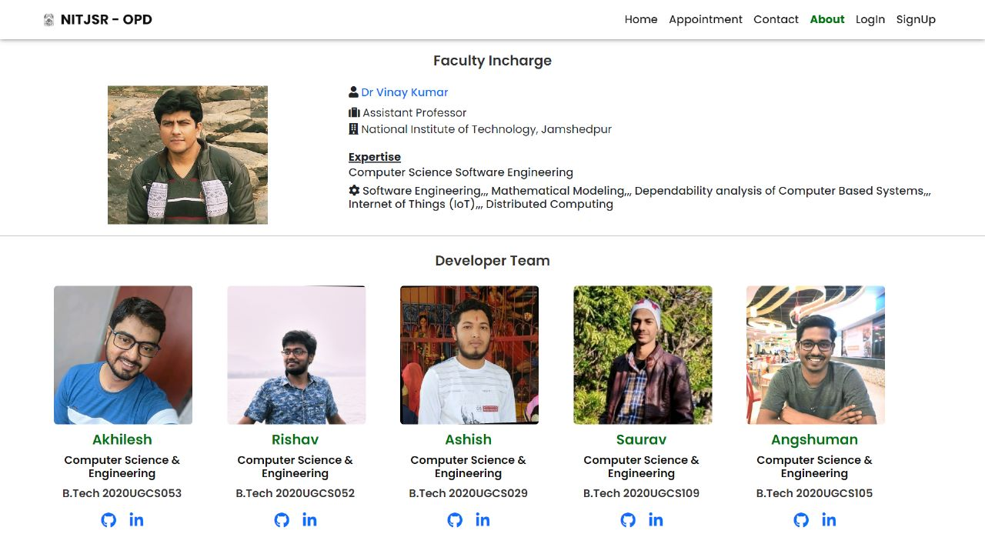
PROJECT OVERVIEW
About Section
It contains details of faculty incharge and Web Developers of this project.

Slide 16
TECH STACK USED :
HTML
HTML stands for Hyper Text Markup Language
HTML is the standard markup language for creating Web pages
HTML describes the structure of a Web page
HTML consists of a series of elements
HTML elements tell the browser how to display the content
HTML elements label pieces of content such as "this is a heading", "this is a paragraph", "this is a link", etc.

Slide 17
CSS
CSS stands for Cascading Style Sheets
CSS describes how HTML elements are to be displayed on screen, paper, or in other media
CSS saves a lot of work. It can control the layout of multiple web pages all at once
External stylesheets are stored in CSS files

Slide 18
BOOTSTRAP
Bootstrap is a free, open source front-end development framework for the creation of websites and web apps. Designed to enable responsive development of mobile-first websites, Bootstrap provides a collection of syntax for template designs.
As a framework, Bootstrap includes the basics for responsive web development, so developers only need to insert the code into a pre-defined grid system. The Bootstrap framework is built on Hypertext Markup Language (HTML), cascading style sheets (CSS) and JavaScript. Web developers using Bootstrap can build websites much faster without spending time worrying about basic commands and functions.

Slide 19
JavaScript
Whether you plan to specialize in front-end, back-end, or full-stack development, JavaScript is an essential programming language for any web developer. Without JavaScript, we wouldn't have the dynamic and interactive websites that have become the standard user experience we all know, love, and rely on. JavaScript makes websites dynamic. Before JavaScript, websites were created using only HTML and CSS. HTML and CSS are only capable of creating static pages that can be styled, but not interactive, except for hyperlinks. Most websites, including the most popular ones like Google, YouTube, and Facebook, use JavaScript. JavaScript is best known as a web language because it is native to the web browser. The web browser naturally understands the language. For Frontend, we have also used Bootstrap, which is a free open-source front-end development framework for building websites and web applications. It is designed to enable responsive mobile web development

Slide 20
REACT JS
React.js is the most popular front-end JavaScript library for building Web applications. Most of the popular websites including the ones designed for popular companies use ReactJs. React.js is an open-source JavaScript library that is used for building user interfaces specifically for single-page applications. It’s used for handling the view layer for web and mobile apps. React also allows us to create reusable UI components. React allows developers to create large web applications that can change data, without reloading the page. The main purpose of React is to be fast, scalable, and simple. It works only on user interfaces in the application. This corresponds to the view in the MVC template. It can be used with a combination of other JavaScript libraries or frameworks. React creates an in-memory data structure cache which computes the changes made and then updates the browser.

Slide 21
NEWS API – INDIAN HEALTH
News API is a simple HTTP REST API for searching and retrieving live articles from all
over the web. The main use of News API is to search through every article published by over
80,000 news sources and blogs in the last 4 years. We are using this API for getting the
latest news about different diseases spread across India in order to keep ourselves updated
about the various seasonal viruses and flues by accessing the reports provided on the
website.

Slide 22
NODE-JS
Node.js is not a programming language. Rather, it’s a runtime environment that’s used to run JavaScript outside the browser. Node-Js is an open source and cross platform JavaScript run environment. It is a popular tool for almost any kind of project. It executes JavaScript code outside a web browser. It uses event-driven, non-blocking I/O architecture, which makes it efficient and suitable for real-time applications. It provides vast scalability for applications. Node.js, being single-threaded, is capable of handling a huge number of simultaneous connections with high throughput. A vast set of open-source Node.js packages is available that can simplify your work. There are more than one million packages in the NPM ecosystem today

Slide 23
EXPRESS
Express.js, or simply Express, is a backend web application framework for Node-js. Since Express.js only requires JavaScript, it becomes easier for programmers and developers to build web applications and API without any effort. Express.js is a framework of Node.js which means that most of the code is already written for programmers to work with. You can build a single page, multi-page, or hybrid web applications using Express.js. Express.js is lightweight and helps to organise web applications on the server-side into a more organised MVC architecture. Express.js provides a simple routing for requests made by clients. It also provides a middleware that is responsible for making decisions to give the correct responses for the requests made by the client. Thus using Express with NodeJs allows us to develop and maintain our backend easily.

Slide 24
MONGO DB
MongoDB is an open source No-SQL database management program. NoSQL is used as an alternative to traditional relational databases. NoSQL databases are quite useful for working with large sets of distributed data. MongoDB is a tool that can manage document-oriented information, store or retrieve information. MongoDB makes use of records which are made up of documents that contain a data structure composed of field and value pairs. Documents are the basic unit of data in MongoDB. MongoDB doesn't require predefined schemas. It stores any type of data. This gives users the flexibility to create any number of fields in a document, making it easier to scale MongoDB databases compared to relational databases. Thus, given its ease of scalability and the flexibility of using any type of data, we used MONGODB as our database.

Slide 25
FIREBASE
Firebase is a Backend-as-a-Service (Baas). It provides developers with a variety of tools and services to help them develop quality apps, grow their user base, and earn profit. It is built on Google’s infrastructure.
Firebase is categorized as a NoSQL database program, which stores data in JSON-like documents.

Slide 26
CONCLUSION
The assignment underwent variety of compiling, debugging, casting off errors, making it malicious
program free, adding greater facilities in health centre control device and interactivity making it more
reliable and useful. The entire challenge has been advanced and deployed as per the requirements
said via the consumer. it's far located to be trojan horse loose as in step with the trying out requirements
which might be applied.
There are also few features which can be integrated with this system to make it more flexible. Below
list shows the future points to be consider:
Billing and payment system can be added.
Security of the whole system
Staff management (work roster, availability, scheduling)
Management functions (report generations, accounting)
Comprehensive database
Web Interface (proposed for future)
Finally, we like to conclude that we put all our efforts throughout the development of our project and
tried to fulfil most of the requirements of the user.

Slide 27
FUTURE SCOPE
Billing and payment - The purpose of billing is to bill the claims for in-patient and out-patient services provided by hospitals or healthcare organizations. Hospital billing is also termed as institutional billing based on the same reason. So we would be providing the patients with an invoice of the medicine.
Security of the whole system - Cyber security is the practice of defending computers, servers, mobile devices, electronic systems, networks, and data from malicious attacks. It's also known as information technology security or electronic information security. The term applies in a variety of contexts, from business to mobile computing, and can be divided into a few common categories. So we would be providing the security to the system from malware attacks.

Slide 28
Staff management (work roster, availability, scheduling) - Currently staff people get their work roster in offline mode but with help of our website they would be getting their work roster in online mode via a mobile having internet connection.
Improvement in SEO - SEO means Search Engine Optimization and is the process used to optimize a website's technical configuration, content relevance and link popularity so its pages can become easily findable, more relevant and popular towards user search queries, and as a consequence, search engines rank them better.
Comprehensive database - As of now all the data is stored in papers and these are filling the cabinets.ye wala baki hi h.. isko pura karega to btana

Slide 29
THANK YOU !!!

